Slide 1


The Peninsula Compost Group
5586 Post Road, Suite 208
East Greenwich, RI 02818
www.peninsula-compost.com
Notes:
11

Slide 2
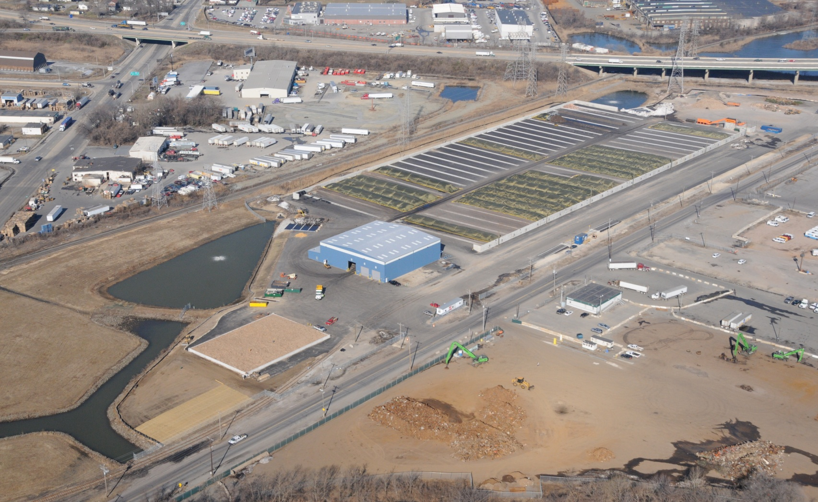
Aerial View of
Wilmington Facility
Notes:
22

Slide 3
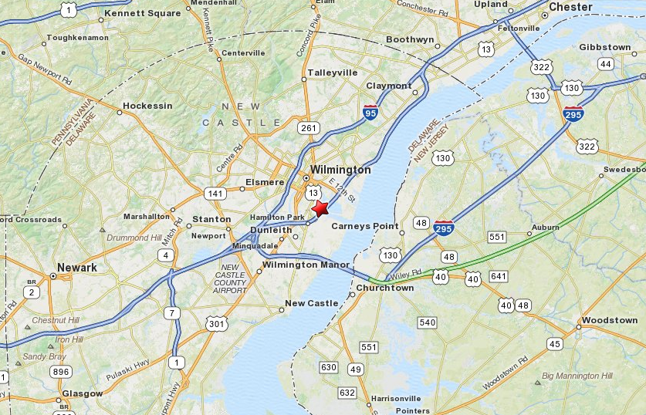
Location Map
Notes:
Aerial View of Wilmington
33

Slide 4
Site Specific Issues
Zoning - Heavy Industrial
Proximity to Residential
DNREC Permit Requirements
Neighborhood Support - Community Benefits Agreement
Notes:
44

Slide 5
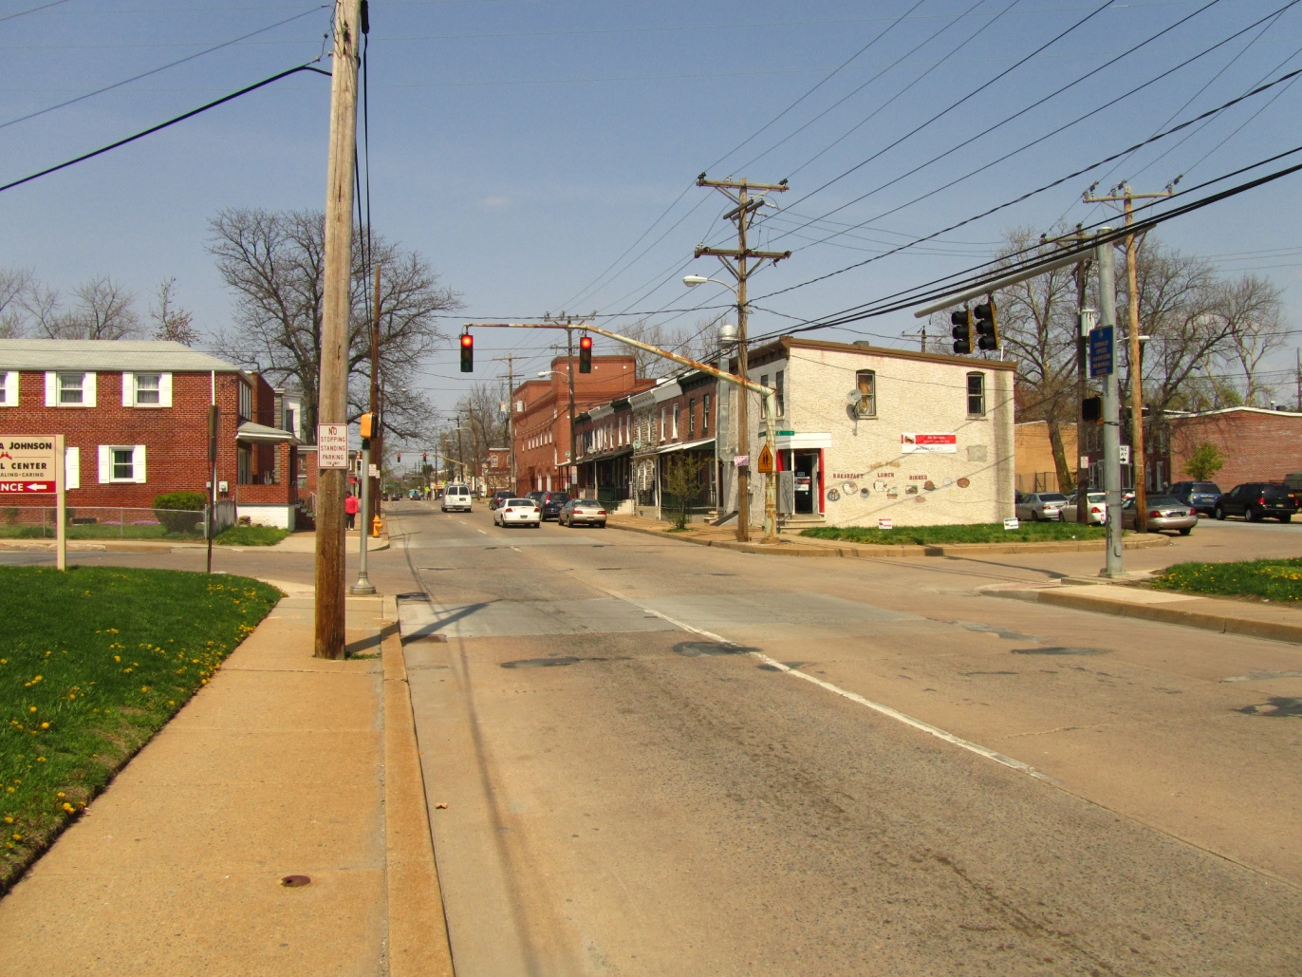
Southbridge Community

Slide 6
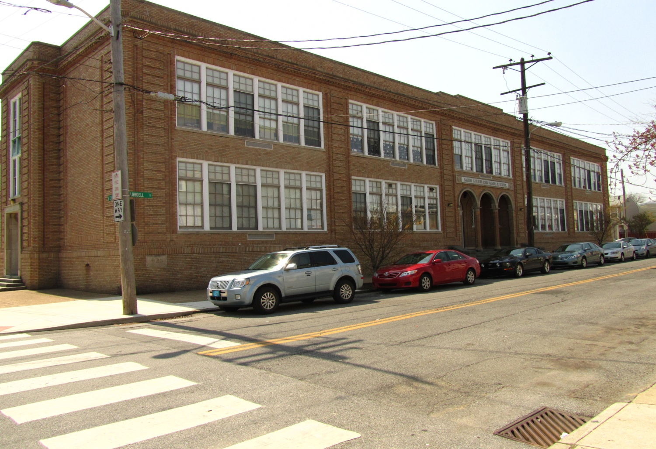
Southbridge Community

Slide 7
Challenges
- Past Experience and Abuses
- Fear of Unknown
- Impact to Community
- Benefit to Community

Slide 8
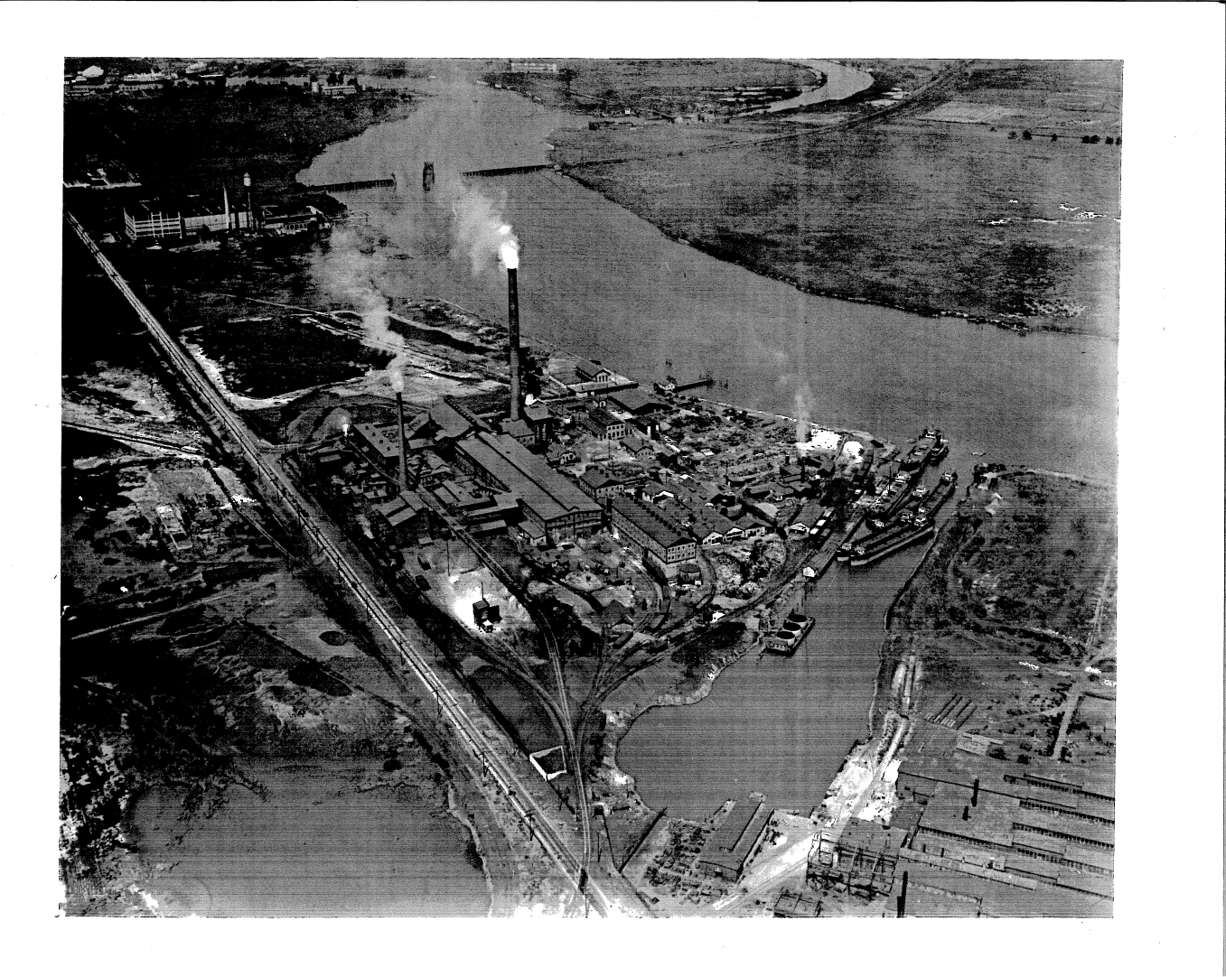
Former Use

Slide 9
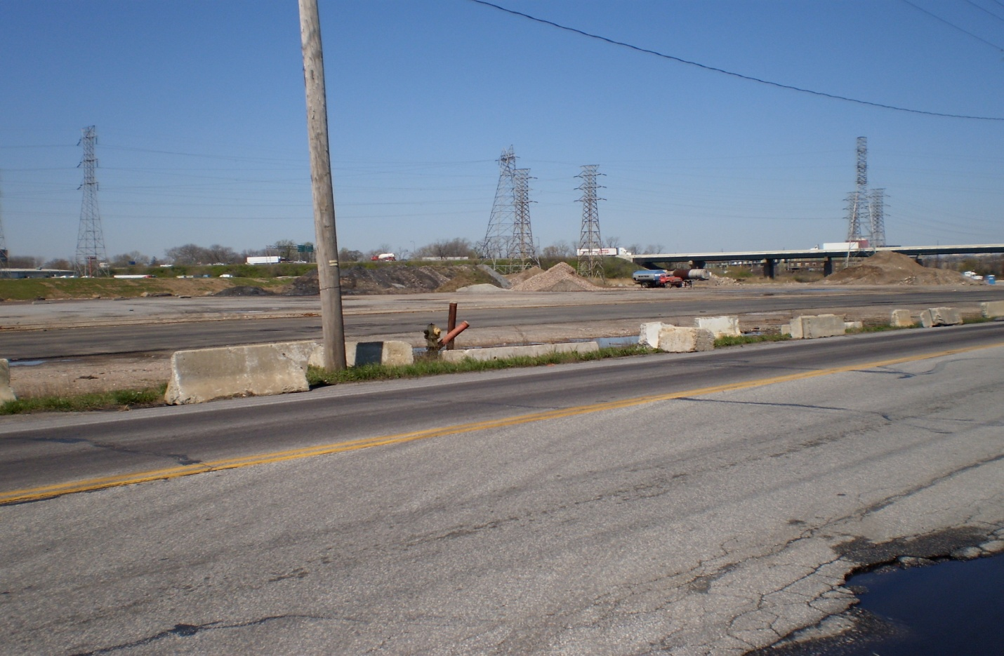
Pre-Construction View
Notes:
Pre-Construction

Slide 10
Answers
- Open Dialogue
- Transparency

Slide 11
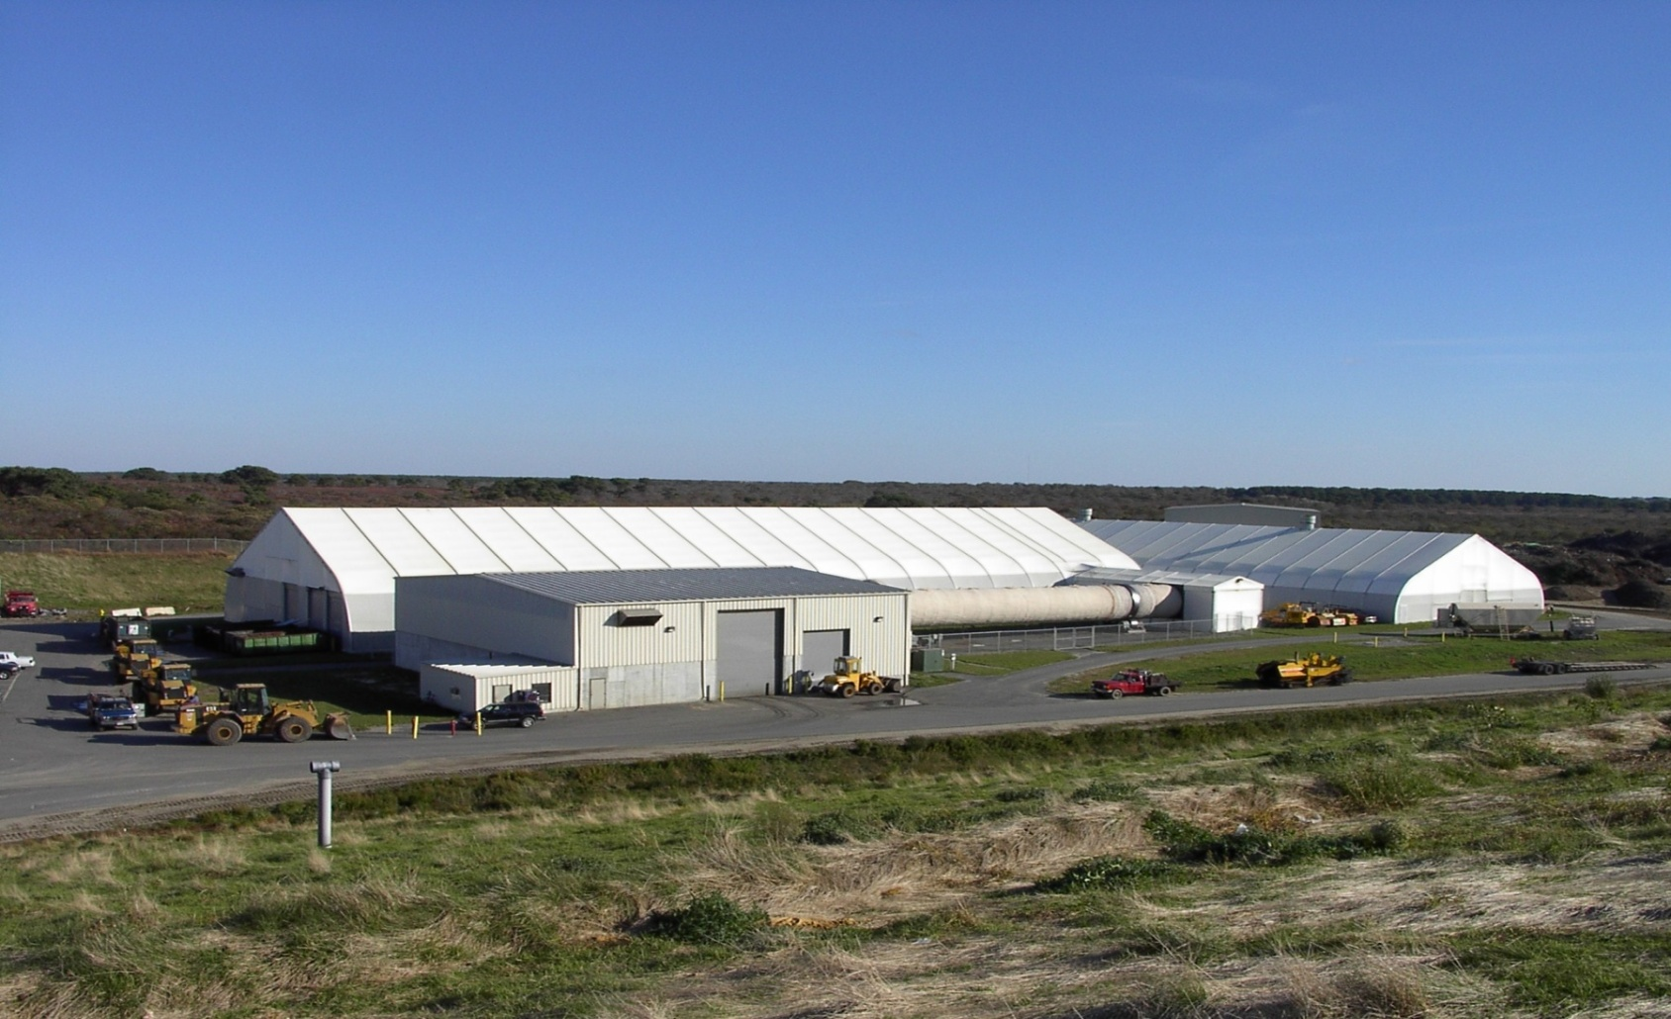
Nantucket Compost Facility
Notes:
1111

Slide 12
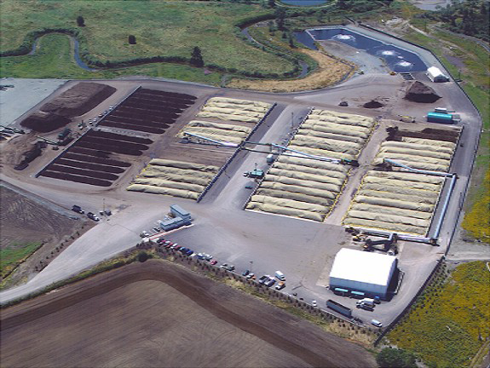
Cedar Grove Aerial

Slide 13
Community Benefits Agreement
Neighborhood Protection
- Traffic Prohibition
- Nuisance Complaint Hot Line
Jobs
- During construction
- Full time

Slide 14
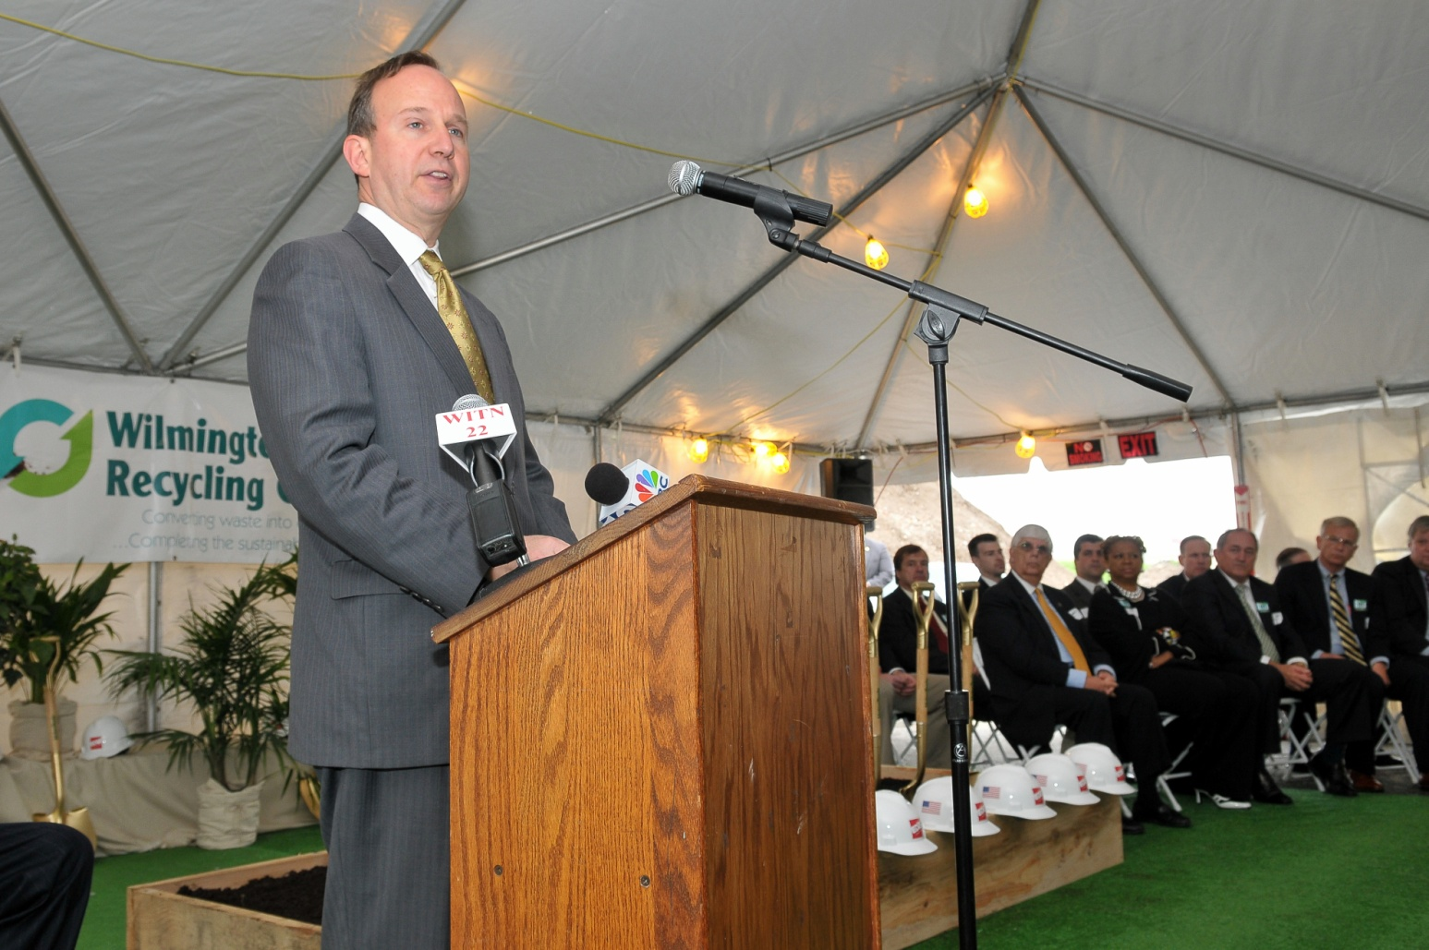
Groundbreaking speaker
Governor Jack Markell

Slide 15

Earth Day Speaker
Hanifa Shabazz

Slide 16
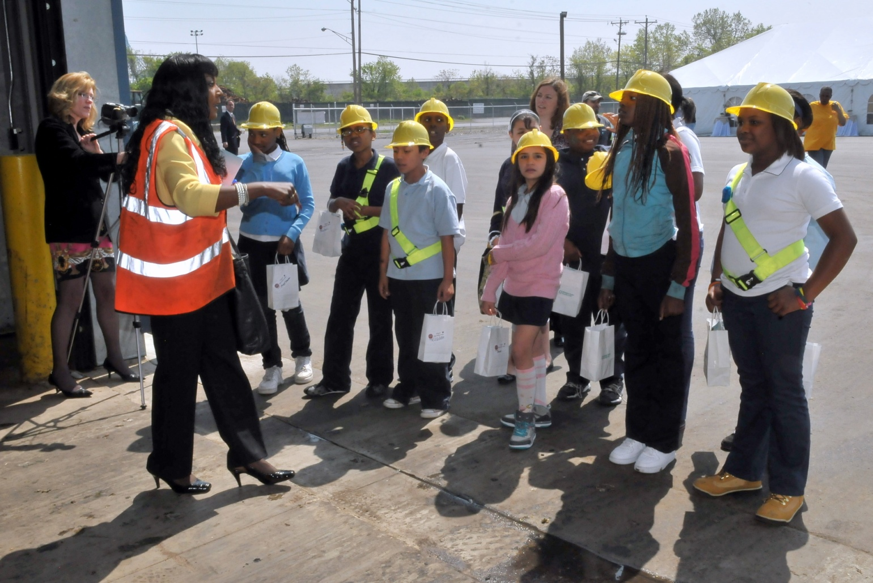
Educating Students

Slide 17
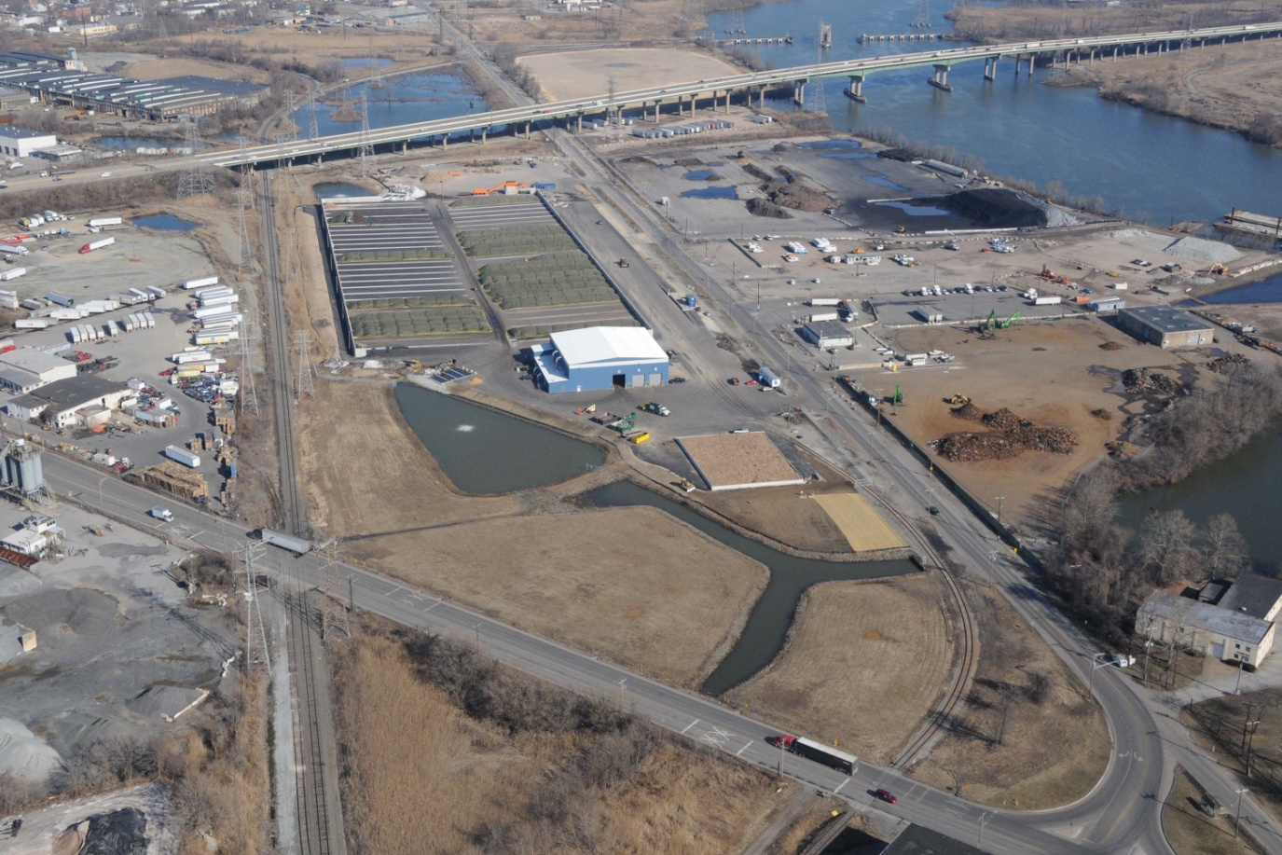
Completed WORC Facility
Notes:
Aerial of Wilmington Facility

Slide 18
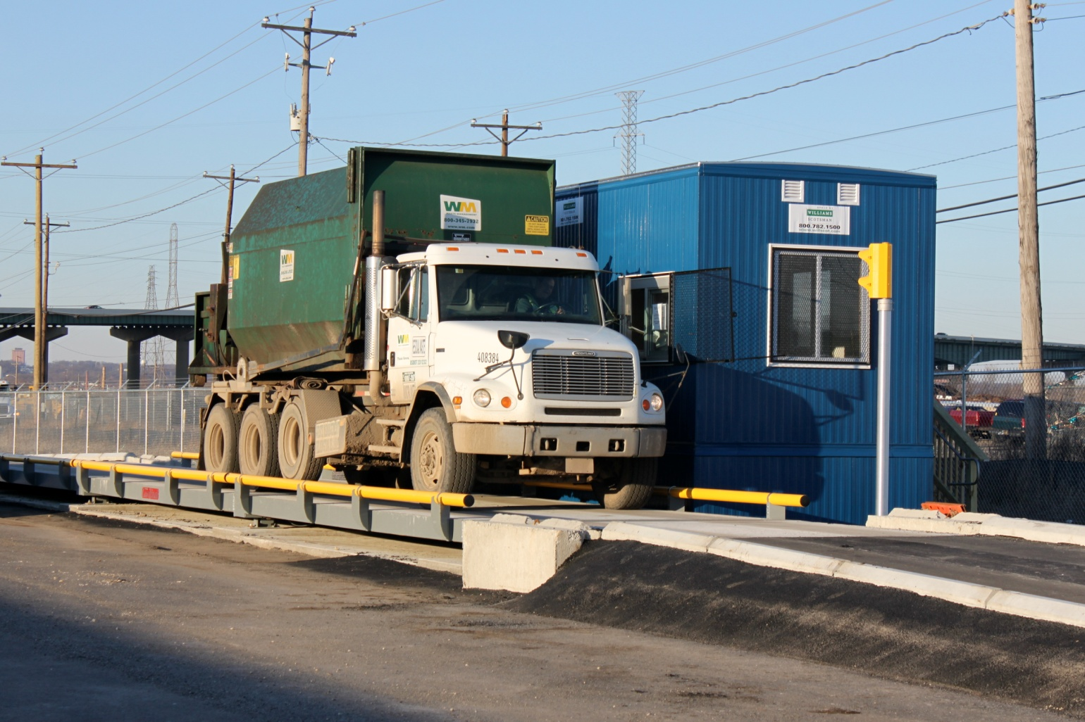
Weighing Inbound Food
Notes:
1818

Slide 19
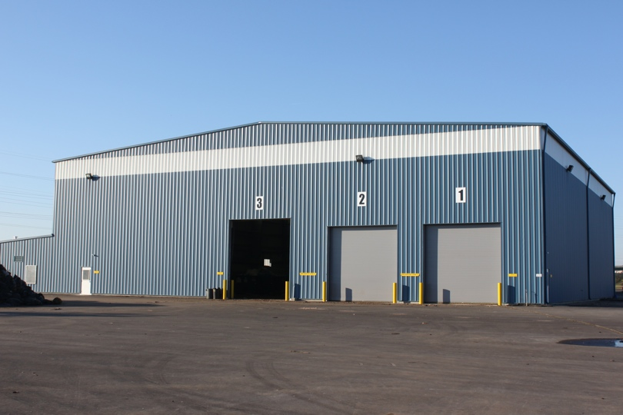
Receiving Building
Notes:
1919

Slide 20
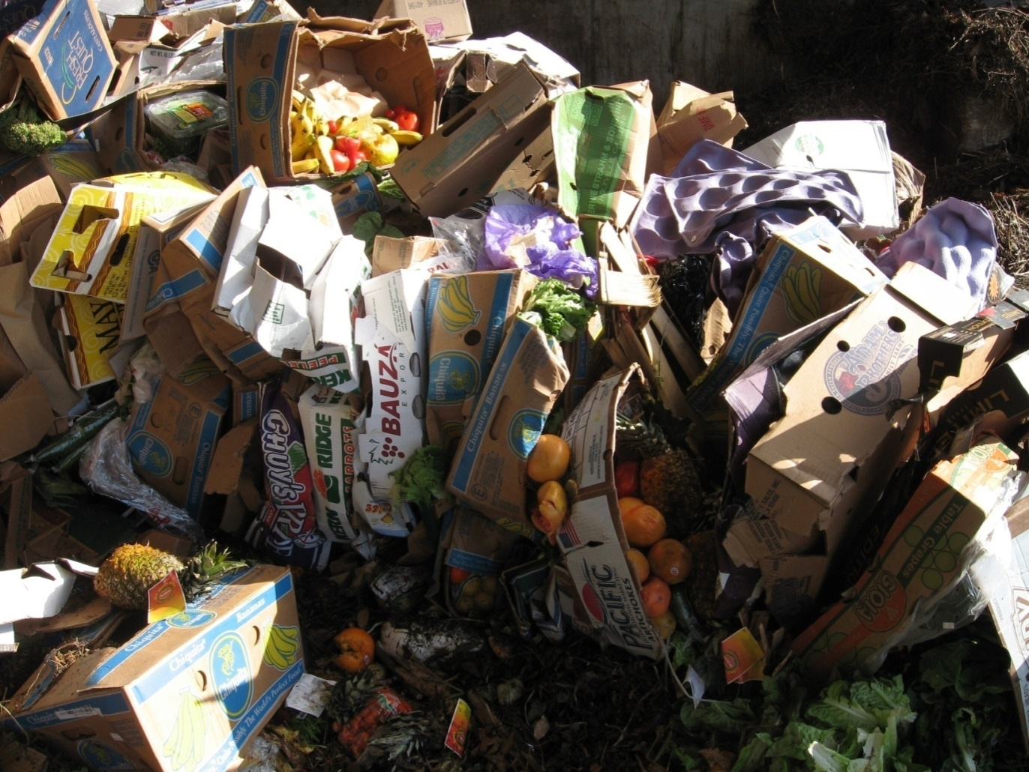
Source Separated Food
Notes:
2020

Slide 21
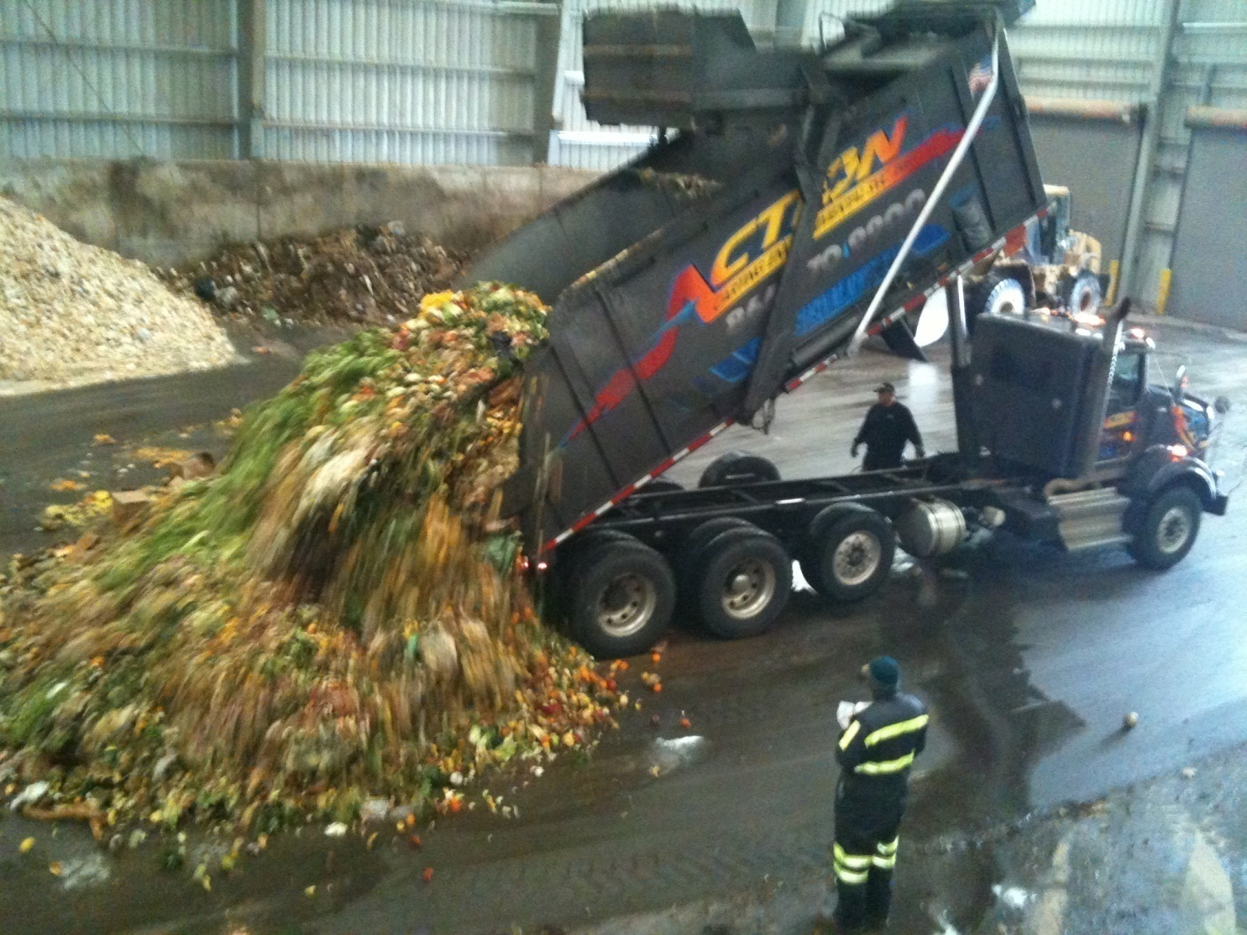
Receiving Building Inspection
Notes:
2121

Slide 22
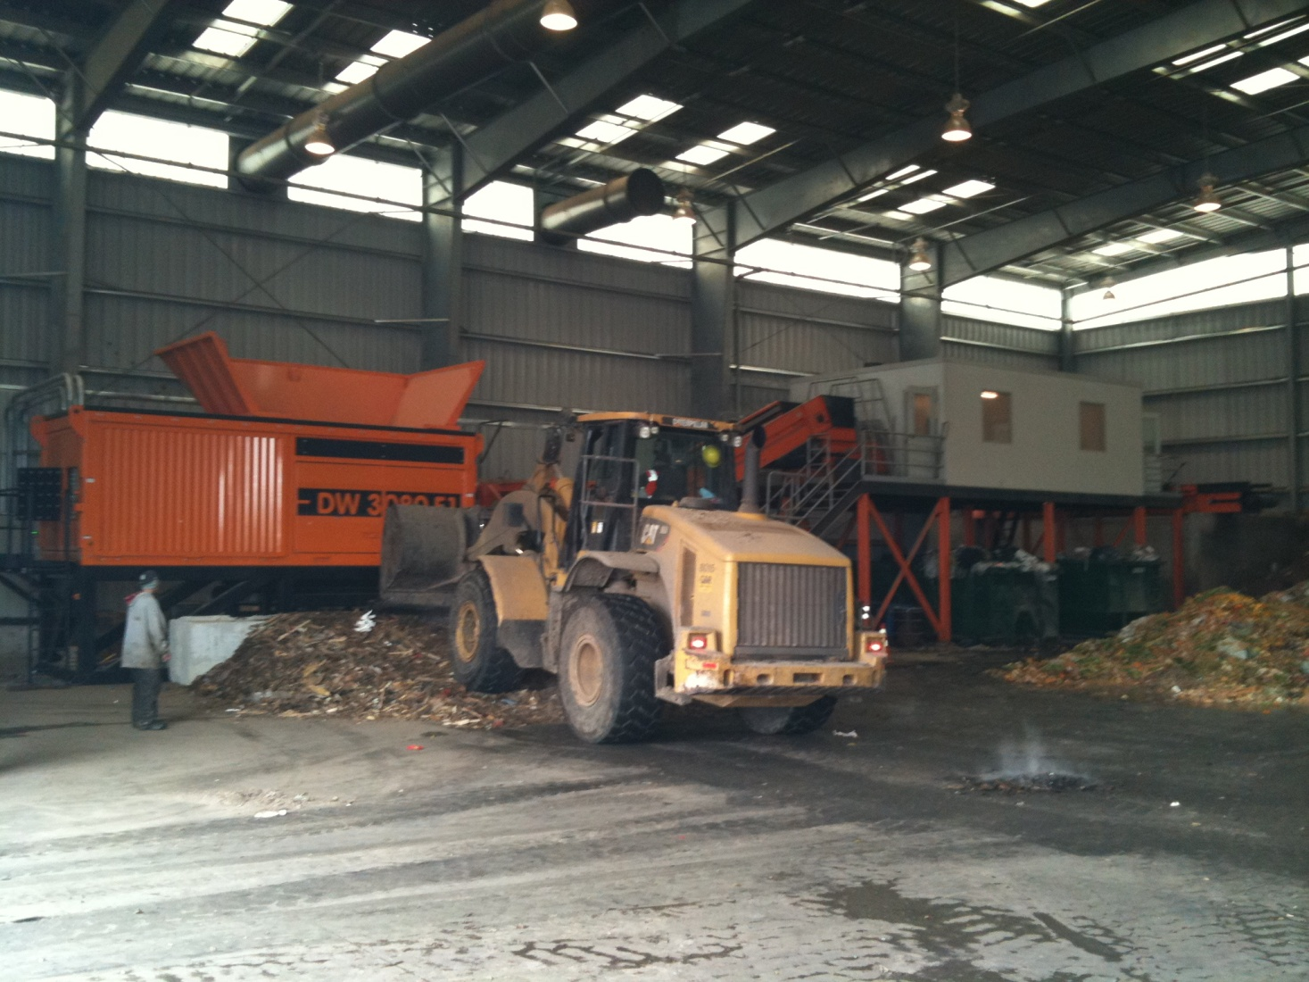
Blending and Shredding
Notes:
2222

Slide 23
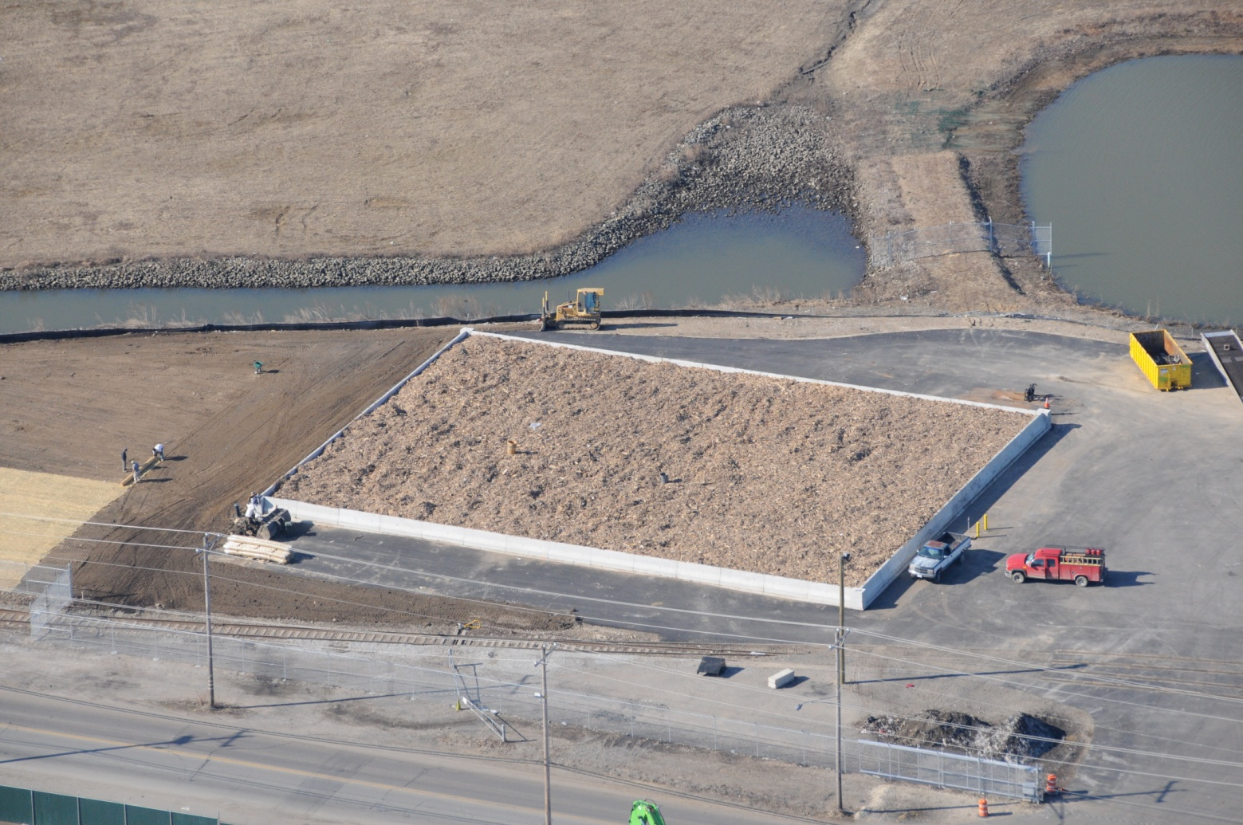
Biofilter Odor Control
Notes:
2323

Slide 24
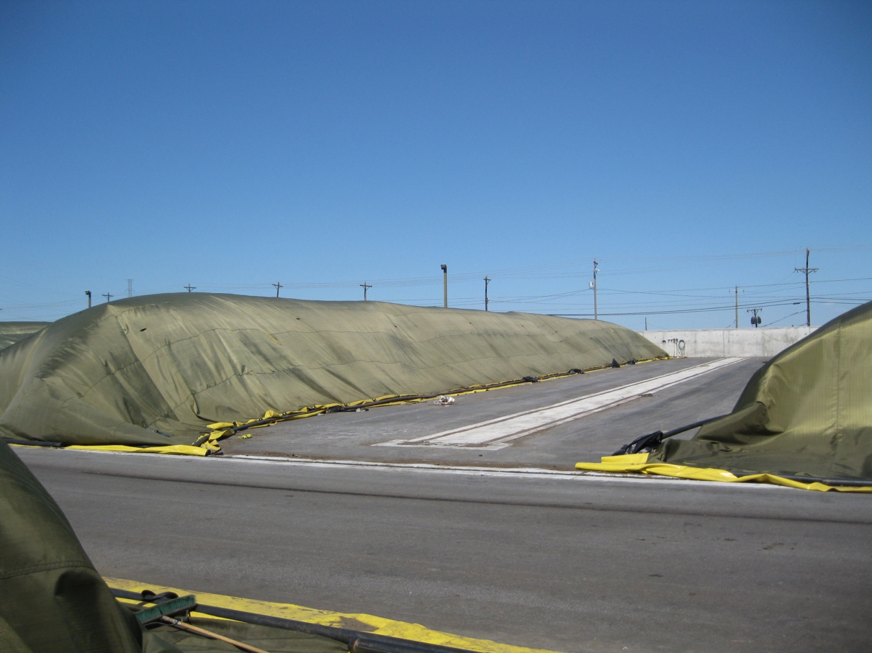
Gore Covers
Notes:
2424

Slide 25
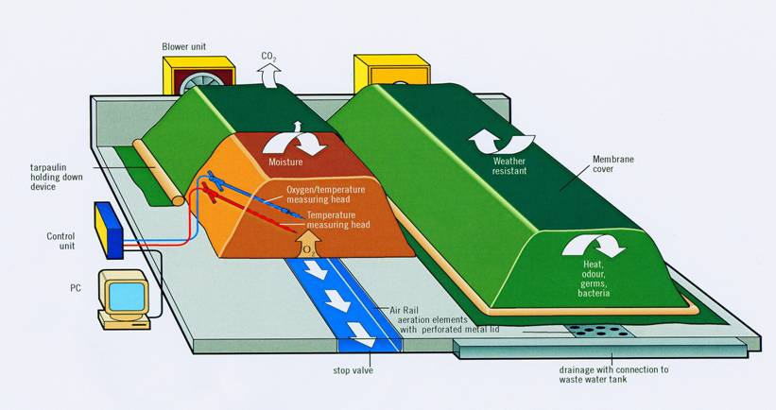
GORE™ COVER SYSTEM
Notes:
2525

Slide 26
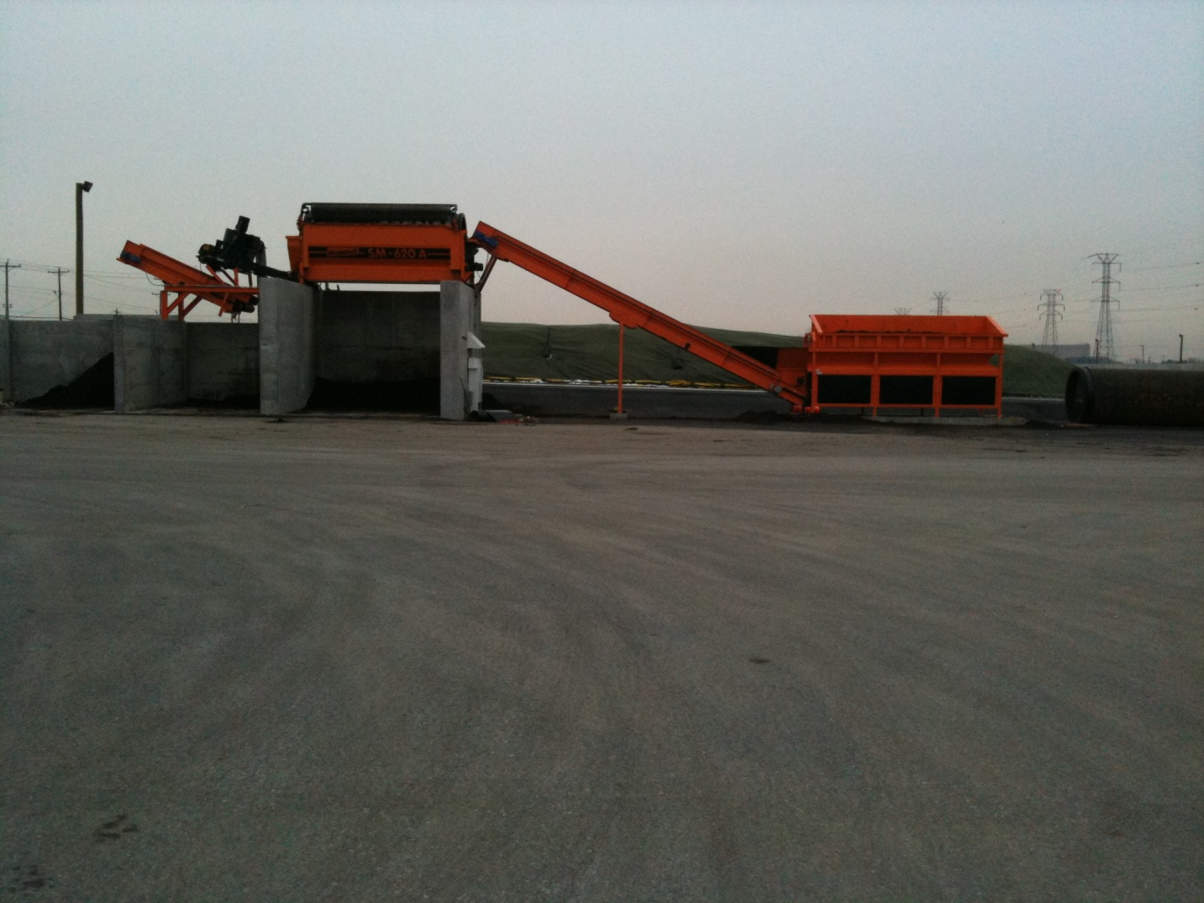
Compost Screening
Notes:
2626

Slide 27
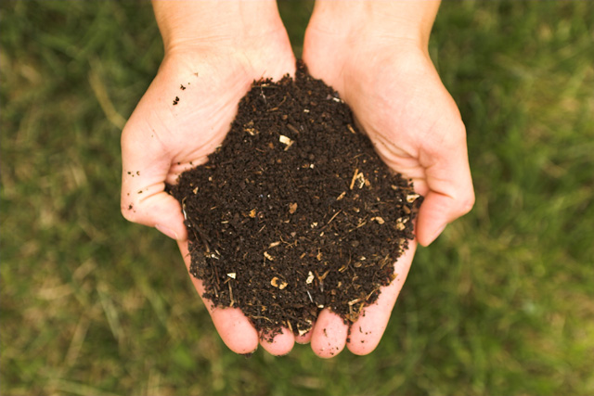
The End Result
Notes:
2727

Slide 28
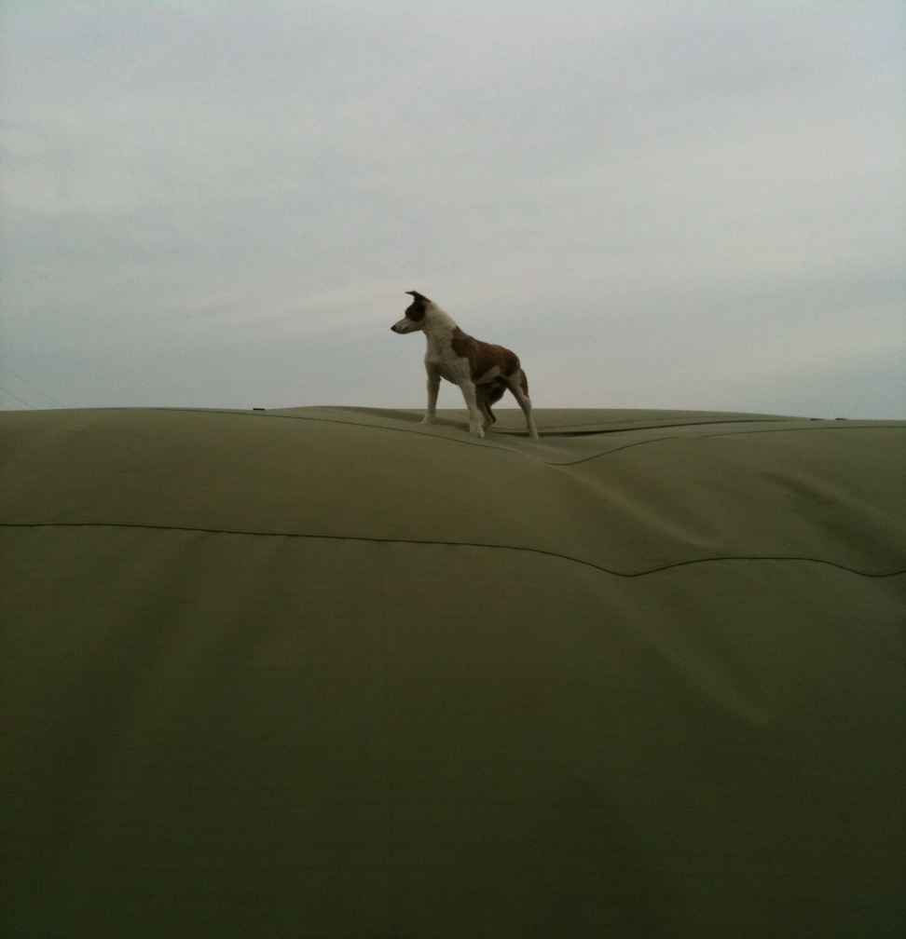
Super Cooper the Compost Dog
Notes:
2828

Slide 29
Mutual Benefits
Peninsula
- Successful Project
- Neighborhood Support
- Committed Local workforce
Southbridge
- Neighborhood Protection
- Green Industry
- Jobs

